Slide 1
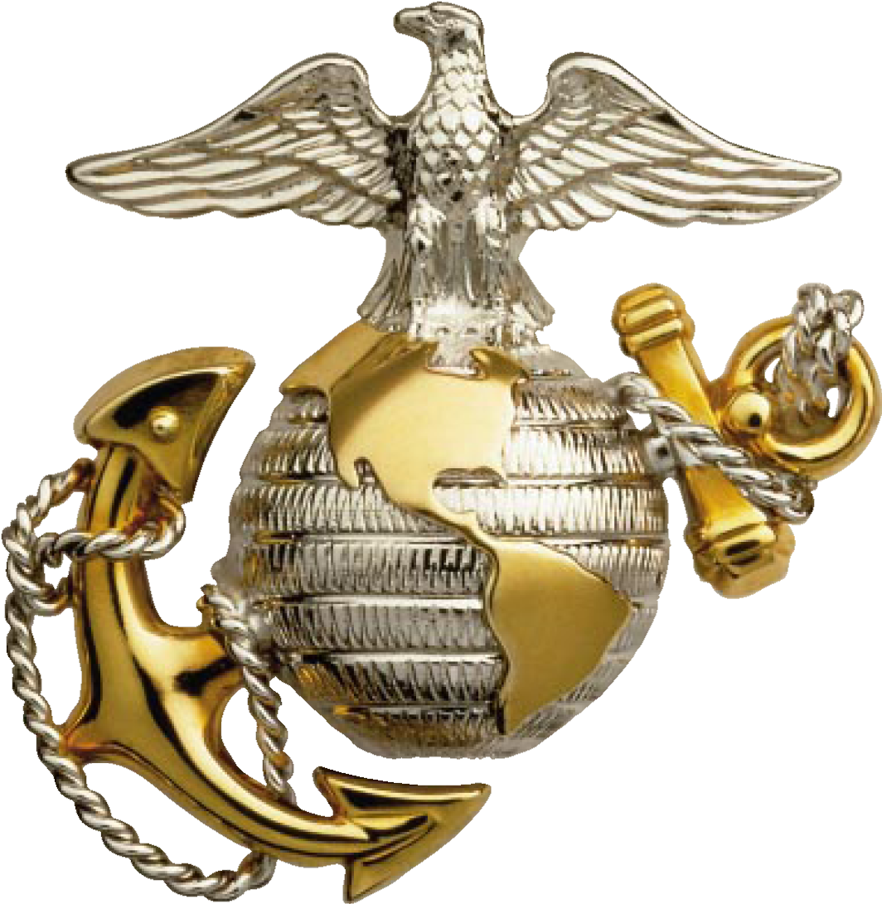
USMC
Summer
Leadership and
Character Development Academy

Slide 2
Summer Leadership and Character Development Academy
A strategic initiative designed to attract our nation’s top-performing high school students by offering a one-week leadership program in the Washington, D.C. area
  Provide leadership training, character development, ethics lessons, and college admissions guidance
  Leadership opportunity and personal development with a community service component
  Most activities located at Quantico, VA
  Pilot program: ~50 high school rising juniors/seniors
  August 6-11, 2012 (Monday-Saturday)

Slide 3
Key Components of the Program
Team Building
Leadership & Ethics Case Studies & Activities
Daily Physical Fitness Classes
Distinguished Speakers
Community Service Project
College Visit (Admissions Counseling, Essay Writing, Interviewing basics)
NROTC-Marine Option and Other Officer Program Opportunities
Washington D.C. visit

Slide 4
Itinerary Aug 6-11
* Subject to change based on schedule dates and availability
Day 1
Arrival
  Arrival and Welcome @ National Museum of the Marine Corps (1200-1600)
  Cadre introduction and Team Building
  Entrance Survey
  Guest Speaker
  Movement to Marine Corps Base Quantico
  USMC Leadership Traits & Principles Class
Day 4
Teamwork
&
Service
  Morning Physical Fitness (PT) Modified CFT
  Teamwork and Span of Control Class
  Community Service Project with Habitat for Humanity
Day 2
Ethics,
Education
&
Leadership
  Morning Physical Fitness (PT) Modified PFT
  Marine Corps Leadership Seminar Part 1
  Marine Corps University Education Brief
  Integrity/Ethics discussion
  Visit Marine Helicopter Squadron 1 (HMX-1)
  Guest Speaker
Day 5
College Prep
&
Wash DC Visit
  Visit George Washington University
    Admissions & Financial Aid guidance
    NROTC and Officer Programs
  Visit Washington DC (Mall area)
  Guest Speaker
  Evening Parade at Marine Barracks Washington
Day 3
Leadership
&
Teamwork
  Morning Physical Fitness (PT) Crossfit
  Marine Corps Leadership Seminar Part 2
  The Basic School (TBS) Package
    Leadership & Teamwork classes and practical application (field exercise)
Day 6
Departure
  Closing breakfast
    Week in review
    Exit Survey
  Clean-up and pack
  OCS Graduation Ceremony 0900
  Reunion with Families@ National Museum of the Marine Corps

